Slide 1
Coursenator
The Course Finder
Theme: Education
Team: Nextgencode

Slide 2
Problem statement
With the onset of the Coronavirus pandemic, Education, specifically in India, came to a stand still. The conventional curriculum fails to provide enough emphasis on the practical learning and continues ignoring the upcoming modern “Tech Stacks”.
The only respite to students in technology is emerging through online learning platforms like Udemy, Coursera, EDx, etc.
But having too many options comes as a bane with a fear of missing out on the best deals, or the popular courses available.

Slide 3
Our Idea
To develop an web application which will very efficiently help the user to draw a comparison of the various courses, perform a filtered search and hence overcome the Fear Of Missing Out (FOMO) on the best deals possible.
This would reduce the strain of physically logging onto every available site,and evaluating the pros and cons to a single click. It would also help the students to
Keep updated with latest courses, which are generally missed out.

Slide 4
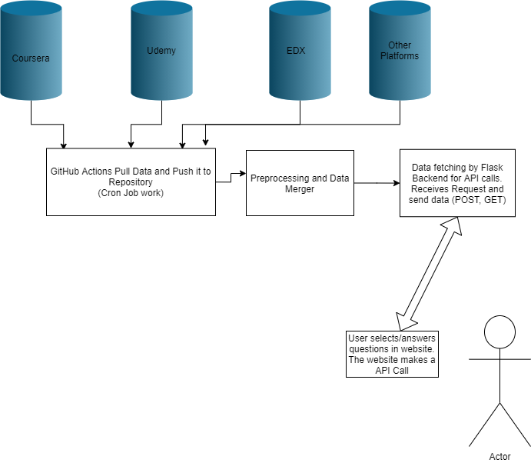
Application Flow

Slide 5
Initial Tech Stack
HTML
CSS
JS
Python (Flask or FastAPI)
Jinja Templating
Heroku and GitHub Pages
GitHub Actions

Slide 6
Challenges
The major challenge is gathering the right and clean data from different sources (Course Platforms) as per the required format. There is bound to be a mismatch in the details available on various platforms, which needs to be made uniform. For instance, an X platform may not provide Course release date and Y platform does provide.
Since the application is required to store a very large amount of data, its effective management and practices for faster loading of data is challenging. We are planning to use CSVs for now but it can be migrated to Redis or neo4j.

Slide 7
Uniqueness and Relevance of the Idea
It is unique in the way that it will draw a clear comparison between the courses available over a wide range of online platforms, not just one particular one, hence enhancing the user’s ability to come up with a wise decision.
The product is extremely relevant to Today’s scenario when all the experiential learning is dependent on online platforms.

Slide 8
Future Scope
We intend to add a course suggester feature to our application. This additional feature would make course suggestions to the user based of various factors including the previously purchased courses, educational qualifications of the user and the likes/ interests of the user.
Our Coursenator would pretend to be Genie and give out suggestions to the user, on the basis of the output derived from our Machine Learning Model.

Slide 9
About The Team :
Kaustubh Gupta ( Team Leader)
Third Year B. Tech (IT) student at Maharaja Agrasen Institute of Technology, Delhi.
(Data Engineering and Backend)
Anshu Varshney
Third Year B. Tech (IT) student at Maharaja Agrasen Institute of Technology, Delhi.
(Backend and Web Design)
Tanushree Ghai
Third Year B. Tech (IT) student at Maharaja Agrasen Institute of Technology, Delhi.
(Web Frontend and Engineering)

Slide 10
Thank You!

